Slide 1



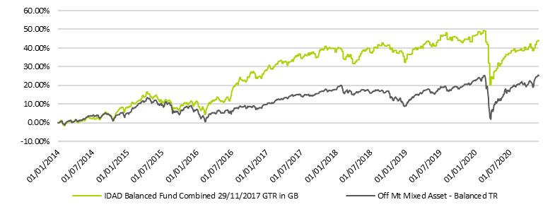
The Global Balanced Portfolio Ordinary GBP November 2020
Investment Objective
Investment Process Overview
The objective of the Global Balanced Fund is to achieve long term Capital Growth using a balanced investment strategy within defined portfolio covariance volatility bands.
The portfolio is invested in a mixture of 8AM Global’s range of actively managed Multi-Asset Funds* and Vanguard Asset Management’s passive Lifestrategy funds.** The active element utilises a strategic blend of the 8AM fund range, while the passive element adds exposure to a large and diverse portion of the market in a cost effective way. By creating a blend of these two complimentary investment styles, the model portfolio is able to offer the cost-effective benefits of passive investment with the added value of active fund management. The best of both worlds.
*For information on 8AM’s range of funds, please visit the website www.8amglobal.com **For information on Vanguard's range of funds, please visit the website www.vanguard.co.uk
8AM
MSP III
8AM
MSP IV
Current Balanced Fund Holdings
8AM
MSP II
Fund Name | %
EF 8AM Focused | 23.19
Vanguard Lifestrategy 60% | 21.72
EF 8AM Multi-Strategy III | 18.07
Natixis Multi-Asset 60-60 Memory Income Autocall | 15.29
EF Tactical Growth | 10.27
EF 8AM Multi Strategy Portfolio IV | 6.73
Vanguard Lifestrategy 80% | 4.73
8AM
Tactical
Growth
Active
Funds
50%
8AM
Focused
Vanguard
Lifestrategy
20
50%
Passive
Funds
Vanguard
Lifestrategy
100
Vanguard
Lifestrategy
40
Vanguard
Lifestrategy
80
Vanguard
Lifestrategy
60
Cumulative Performance*
Risk Profile
6/10
*Previous Performance from 01/01/2014 to 28/11/2017 has been generated from back-testing of fund holdings using our historic portfolio modelling.
Performance from 29.11.2017 | 1 m | 3m | 6m | 1 yr | YTD | Since Launch
IDAD Balanced Fund (GBP) | 3.91% | 3.20% | 7.11% | -1.27% | -1.92% | 3.01%
Offshore Mixed Asset Balanced Sector | 5.23% | 3.13% | 8.71% | 3.46% | 2.22% | 6.69%
Source: Abacus/Offshore Mixed Asset Balanced Sector
Investment Manager Commentary
November was yet another extraordinary month, in an extraordinary year, for financial markets. The month began with a burst of optimism when it became clear that Joe Biden would be the next President of the US and that the Republicans would hold the Senate, with this viewed as a perfect scenario for growth companies. Technology shares surged, but this sector move proved to be short lived as news of successful vaccine trials from Moderna and Pfizer boosted hopes of the world returning to normal and the market rotated into economically sensitive sectors including bombed out value plays at the expense of growth companies.
The Global Balanced Portfolio maintains a balanced exposure to both growth and value plays through a diversified portfolio of active holdings and passive trackers so should benefit in equal measure from the general uptrend in risk assets. It achieved respectable growth of 3.91% last month, inching closer to the level it began this tumultuous year.
You may be forgiven looking at the strong gains from equity markets for thinking that the world was getting back to normal. This is far from the case as the virus continues to devastate large swathes of the global economy. But markets always look forward and investors are anticipating 2021 as the year when the world eventually gets back to normal and that monetary and fiscal largesse can provide the necessary back stop until the good news comes as vaccines are deployed. Expect a choppy end to the year, but your managers side with the consensus view that financial assets have a good chance of delivering strong positive returns next year.
Source: IDAD/Bloomberg

Slide 2
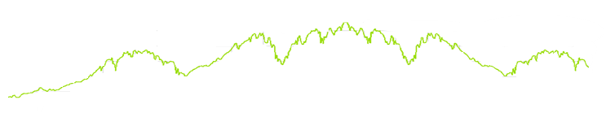
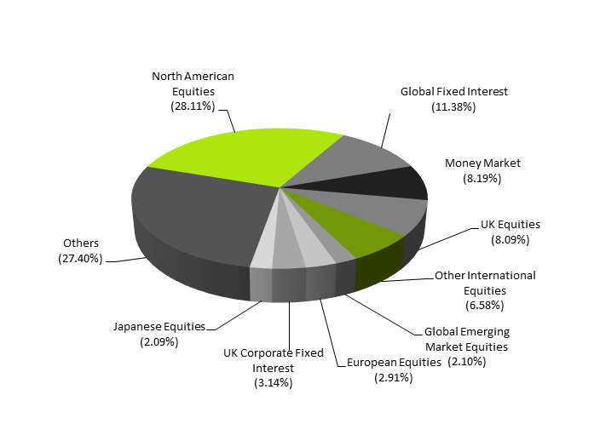
The Global Balanced Portfolio Ordinary GBP
Risk & Reward
KEY FACTS
Investment Manager: 8AM Global LLP
Price (GBP): 1.0301
Portfolio Launch: April 2017
Fund Launch: 29 November 2017
Fund Domicile: Isle Of Man Regulated Fund
Allocation: 100%
Early Exit Charge: 5% over 5 years reducing on a sliding scale
Performance Fee: 10% on profits over 10% p.a. (on a High Watermark basis)
AMC: 1.5% per annum
Investment Management: 0.2% per annum
(Investment Management fee included in AMC)
Liquidity & Dealing: Weekly
NAV Date: COB Wednesday
Dealing Day: Thursday
(Deadline for subscriptions & redemptions COB Tuesday)
Minimum Investment: £1,000
Traditional investment styles offer fixed asset allocation and variable volatility. 8AM Global prefers to offer investors fixed volatility (within a pre-set range) and variable asset allocation. In this way the investor remains within a risk band that has been chosen from the outset and the manager will adjust the asset allocation to ensure that this remains the case.
The portfolio is suitable for an investor with a time horizon in excess of five years and who understands the risks and rewards of equity and bond investment.
9.5
Risk Profile
8AM’s investment process actively changes asset allocations within the portfolio in order to keep the level of volatility between discrete bands with defined upper and lower tolerances. This ensures that the portfolio remains exposed to a controlled level of market volatility as selected by the investor at the outset.
6/10
8.0
*Graph used for illustrative purposes only
Asset Allocation
ISIN: IM00BYX8TN47 (GBP)
Source: Abacus/8AM GLOBAL
Contact Information
Investment Manager
8AM GLOBAL LLP
The Thatched Office
Kimpton
Andover, Hampshire
SP11 8PG
Phone: +44 (0) 1424 777600
Email: ash.weston@8amglobal.com
www.8amglobal.com
Promoter
IDAD Limited
2 Rotherbrook Court
Bedford Road
Petersfield
GU32 3QG
Phone: +44 (0) 1730 263943
Email: enquiries@idad.com
www.idad.com
Manager
Abacus Financial Services Limited
1st Floor
Sixty Circular Road
Douglas, Isle Of Man
IM1 1AE
Phone: +44 (0) 1624 689750
Email: afsl@abacustrustgroup.com
Fiduciary Custodian
Apex Financial Services (Corporate)
Limited
12 Castle Street
St Helier, Jersey
JE2 3RT
Tel: +44 (0)1534 712500
www.theapexgroup.com
This document is intended for Professional Advisers and Intermediary use only. This document which is issued by IDAD Limited, does not constitute an offer to invest in the Fund, and any decision to invest must be based solely on information contained in the offering documents. Copies of the offering documents, documents constituting the Fund and the latest financial statements for the Fund may be obtained free of charge from the Promoter at the address set out above. It should be remembered that the value of shares in the Fund and the income produced by them could fall as well as rise. Investors may not get back the value of their original investment. The Fund is not subject to the benefit of any compensation arrangements.
The Manager is a holder of a Financial Services Licence issued under section 7 of the Financial Services Act 2008 and is licensed by the Isle of Man Financial Services Authority. The investments are advised upon and managed by 8AM Global LLP, which is authorised and regulated by the Financial Conduct Authority. IDAD Limited is the Promoter of the Fund and is authorised and regulated by the Financial Conduct Authority FCA FRN 740499. The Fiduciary Custodian is licensed by the Jersey Financial Services Commission to provide custody services to collective investment schemes and is approved to act as fiduciary custodian to the Fund. In granting permission for the Manager to manage the Fund, the Isle of Man Financial Services Authority has reviewed the constitutional documents but has not commented on, nor is it required to comment on, the investment objectives or strategies of the Fund or its suitability for any investor or class of investor. Potential investors should be aware that past performance is not an indicator of future performance and that historic performance does not take account of any early exit charges that could apply in the event of a withdrawal being made within 5 years of investing.

